Slide 1
Smart Anesthesia Syringe
Under the guidance of
Internal guide name:
External guide name:
By
Student1
Student2

Slide 2
AIM OF THE PROJECT
The main aim of this project is to design an Anesthesia syringe along with heartbeat and temperature monitoring system using arduino UNO.

Slide 3
Objective
It mainly helps in medical industries in performing major surgeries which takes place longer time durations.
Here we use embedded systems which help us in solving associative problems and provide accurate drug dosages.
Many parameters are taken into consideration to reduce the errors and increase the efficiency of the system.
Keypad based dynamic level setting of Anesthesia.
Design an Anesthesia syringe along with heartbeat and temperature monitoring system.

Slide 4
Literature Survey-1
1. Mihaela Ghita, “CLOSED-LOOP CONTROL OF ANESTHESIA: SURVEY ON ACTUAL TRENDS, CHALLENGES AND PERSPECTIVES” (2020) [1]. The two objectives of this article, as addressed to different entities, are: a) to raise awareness throughout the anaesthesiologists about the usefulness of integrating automation and data exchange in their clinical practice for providing increased attention to alarming situations, and, b) to provide the actualized insights of drug-delivery research in order to create an opening horizon towards precision medicine with significantly improved human outcomes. This article presents a concise overview on the recent evolution of closed-loop anesthesia delivery control systems by means of control strategies, depth of anesthesia monitors, patient modelling, safety systems, and validation in clinical trials. Although the advance in research on both physiology and technology has enabled automation of the complex anesthesia process, the actual control strategies are far from the mature state needed to be integrated in standard hospital use. The issue can be explained by the limitation of the current control systems to not copy the real-life clinical routine of the complex anesthesia by means of integrated regulation of all anesthesia-related drugs.

Slide 5
Literature Survey-2
2.Pierre Humbert, “APPRENTICESHIP LEARNING FOR A PREDICTIVE STATE REPRESENTATION OF ANESTHESIA”, (2020) [2]. In this paper, an original decision support algorithm to assist the anaesthesiologist’s delivery of drugs to maintain the optimal Depth of Anesthesia (DoA). Derived from a Transform Predictive State Representation algorithm (TPSR), the model was learned by observing anaesthesiologists in practice. The model only relied on the four commonly monitored variables: Heart Rate (HR), the Mean Blood Pressure (MBP), the Respiratory Rate (RR) and the concentration of anesthetic drugs (AAFi). Thirty-one patients have been included. The performance of the model is analysed with metrics derived from the Hamming distance and cross entropy. They demonstrated that low rank dynamical systems had the best performances on both predictions and simulations. Then, a confrontation of our agent to a panel of six real anesthesiologist demonstrated that 95.7 % of the actions were valid. But the action may lead to future complications. We measured the frequency of each label. This experiment provides a qualitative evaluation of the actions of the agent, even if they differ from the real anesthesiologist. Indeed, due to anesthetic latency and the nature of our problem, actions that differ from the anesthesiologist might still be valid choices.

Slide 6
EXPECTED PROJECT OUTCOMES
The patient's various parameters are considered and hence the right amount of anesthesia will be provided for the body or a particular part of the body.
Accuracy of the system will be increased from the existing systems by detecting and correcting the errors of the system
The right dosage is injected to the patients automatically if no staff is present near the patient or no response happens from the other end.

Slide 7
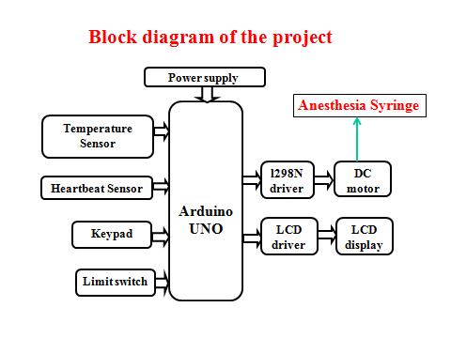

Slide 8
Working
The main controlling device of the project is arduino UNO microcontroller. Temperature sensor, heartbeat sensor, keypad, limit switch and anesthesia syringe along with DC motor is interfaced to the microcontroller.
Microcontroller will continuously read the data from temperature and heartbeat sensors will be display on LCD module.
When the user enters the level of anesthesia using keypad, it will read by the microcontroller and microcontroller will inject Syringe pumps which can accurately move a platform attached to the plunger of a syringe with the help of DC motor. Syringe is connected with DC motor along with l298 motor driver and thread screw mechanism. Based on the anesthesia level microcontroller will control the syringe through DC motor. The main controlling device of the project is Arduino uno, to achieve this task microcontroller loaded program written in embedded c language.

Slide 9
Software’s used:
Embedded C language.
Arduino IDE studio for dumping the code into the microcontroller.
Express SCH for Circuit design.

Slide 10
Hardware
Power supply.
Arduino UNO.
Heartbeat and temperature sensor.
L298 along with DC Motor.
LM35 temperature sensor.
LCD display.
Keypad.

Slide 11
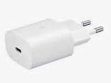
Power Supply
In this project we are using 5v adepter to provide the power supply of the arduino uno along with each module.

Slide 12
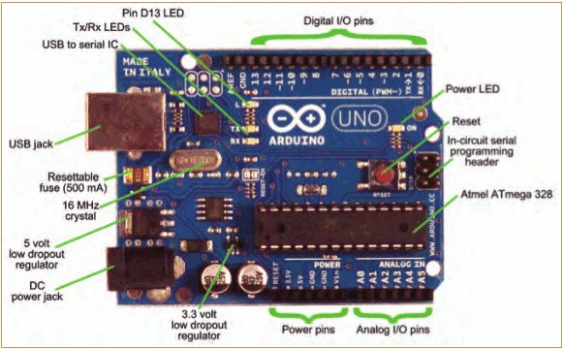
Meet Arduino Uno

Slide 13
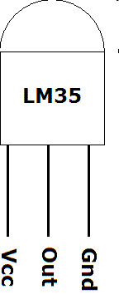
LM 35 (temperature sensor)
A sensor is a device that measures a physical
quantity and converts it into a signal which can
be read by an observer or by an instrument.
The output of the lm 35 temperature sensor is in milli volts (mv).
connect the Vcc Pin to 5v and GND to GND, output of the lm 35 temperature sensor is in the analog form, to convert this into digital form we are going to use analog to digital converter.

Slide 14
LM 35 CHARACTERISTICS
Calibrated in ° Celsius
0.5 ° c accuracy
Rated for full -50 ° c to +150 ° c
Operates from 4 to 30 v
Suitable for remote applications
Low self heating
Low power consumption

Slide 15
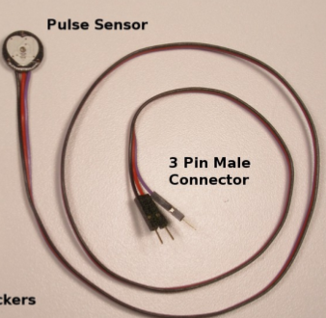
Pulse sensor
Pulse Sensor is a well-designed plug-and-play heart-rate se IR led emits infrared radiation and surface reflects the infrared light. Depending on reflectivity of the surface amount of light reflected varies. This current can be passed through a resistor to get proportional voltage. Thus as intensity of incident rays varies, voltage across resistor will vary accordingly. The result can be displayed on LCD display.

Slide 16
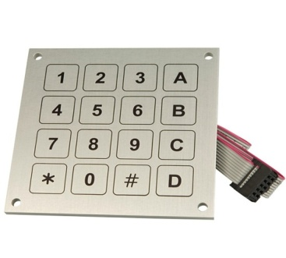
Keypad
A keypad is a set of buttons arranged in a block or "pad" which usually bear digits and other symbols and usually a complete set of alphabetical letters.
If it mostly contains numbers then it can also be called a numeric keypad.
In this project we are using matrix keypad to set the time.

Slide 17
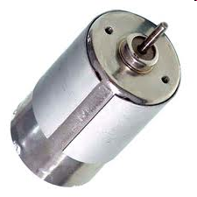
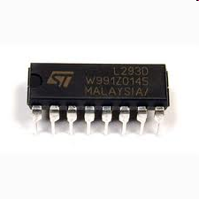
DC motor with driver
A DC motor is a electric motor that works on Direct Current (DC).
Motor supply: 9-15V DC.
DC motor can be made to run in both directions by changing the supply polarities.
Microcontroller cannot run the motor in both directions and is not capable of driving the motor when it is directly connected to it.
So, motor driver (H-bridge IC) is used as an interface between motor and Microcontroller.
Motor driver used in the project is L298.

Slide 18
DC motor
In any electric motor, operation is based on simple electromagnetism. A current-carrying conductor generates a magnetic field; when this is then placed in an external magnetic field, it will experience a force proportional to the current in the conductor, and to the strength of the external magnetic field.
Every DC motor has six basic parts -- axle, rotor (armature), stator, commutator, field magnet's, and brushes. In most common DC motors the external magnetic field is produced by high-strength permanent magnets.

Slide 19
The stator is the stationary part of the motor -- this includes the motor casing, as well as two or more permanent magnet pole pieces. The rotor (together with the axle and attached commutator) rotate with respect to the stator. The rotor consists of windings (generally on a core), the windings being electrically connected to the commutator.
Advantages of DC motor:
High output power relative to motor size and weight.
Encoder determines accuracy and resolution.
High efficiency. It can approach 90% at light loads.
High torque to inertia ratio. It can rapidly accelerate loads.
Has "reserve" power. 2-3 times continuous power for short periods.

Slide 20
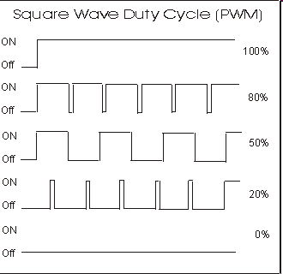
PWM
PWM stands for Pulse Width Modulation
This technique is used to either increase or decrease the ON time of the pulse waveform (i.e., changing the duty cycle).

Slide 21
Motor Driver Module-L298N
The L298N is an integrated monolithic circuit in a 15- lead Multiwatt and PowerSO20 packages. It is a high voltage , high current dual full-bridge driver de-signed to accept standard TTL logic level sand drive inductive loads such as relays, solenoids, DC and stepping motors. Two enable inputs are provided to enable or disable the device independently of the in-put signals .The emitters of the lower transistors of each bridge are connected together rand the corresponding external terminal can be used for the connection of an external sensing resistor. An additional Supply input is provided so that the logic works at a lower voltage.

Slide 22
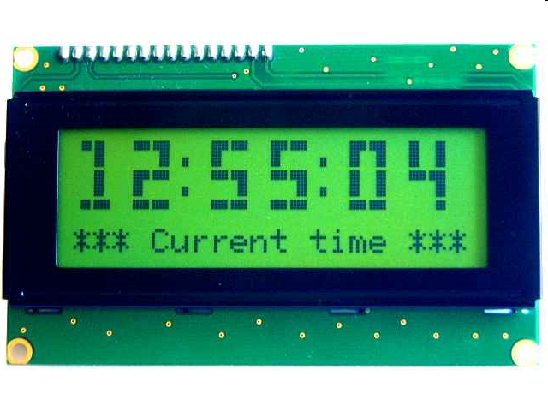
LCD DISPLAY
A liquid crystal display (LCD) is a thin, flat electronic visual display that uses the light modulating properties of liquid crystals.
Liquid crystal display is very important device in embedded system. It offers high flexibility to user as he can display the required data on it.
These are used in a wide range of applications, including computer monitors, television, instrument panels, aircraft, cockpit displays, signage, etc

Slide 23
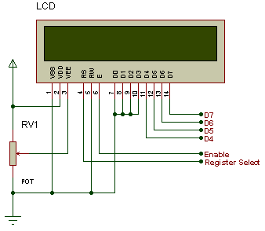

Slide 24
PIN DESCRIPTION
Pin No. | Name | Description
Pin no. 1 | VSS | Power supply (GND)
Pin no. 2 | VCC | Power supply (+5V)
Pin no. 3 | VEE | Contrast adjust
Pin no. 4 | RS | 0 = Instruction input 1 = Data input
Pin no. 5 | R/W | 0 = Write to LCD module 1 = Read from LCD module
Pin no. 6 | EN | Enable signal
Pin no. 7 | D0 | Data bus line 0 (LSB)
Pin no. 8 | D1 | Data bus line 1
Pin no. 9 | D2 | Data bus line 2
Pin no. 10 | D3 | Data bus line 3
Pin no. 11 | D4 | Data bus line 4
Pin no. 12 | D5 | Data bus line 5
Pin no. 13 | D6 | Data bus line 6
Pin no. 14 | D7 | Data bus line 7 (MSB)

Slide 25
Thread screw mechanism
A screw is a mechanism that converts rotational motion to linear motion, and a torque (rotational force) to a linear force.

Slide 26
FUTURE WORK
We can extend this project by adding fall detection system to this project.
We can extend this project by adding more health parameters like glucometer and BP sensors.

Slide 27
REFERENCES
[1]. Mihaela Ghita, “Closed-Loop Control of Anesthesia: Survey on actual Trends, challenges and perspectives''. DOI:10.1109/ACCESS.2020.3037725
[2]. Pierre Humbert, “Apprenticeship learning for a predictive state representation of anesthesia” DOI 10.1109/TBME.2019.2954348
[3]. Xinbai Li, “Automatic positioning and recognition of anesthesia points based on ultrasound image guidance technology”,(2020) DOI:10.1109/ACCESS.2020.3003416
[4]. Fali Li, “Identification of general anesthesia induced loss of consciousness by cross fuzzy entropy-based brain network”, (2021) IEEE transactions on neural systems and rehabilitation engineering'' VOL. 29, 2021
[5]. Kyle Wilcocks, Bill Kapralos, “The Anesthesia Crisis Scenario Builder for Authoring Anesthesia Crisis-Based Simulations” (2021) DOI 10.1109/JBHI.2017.2709841, IEEE Journal of Biomedical and Health Informatics

Slide 28

QUERIES?

Slide 29

THANK YOU

